Slide 1
NM Medicaid Web Portal Registration, Master Administration, & User Workshop
Conduent
Government Healthcare Solutions

Slide 2
Purpose
The purpose of this workshop is to provide an overview of the New Mexico Medicaid Web Portal provider functionalities. We will also provide instructions on how to utilize, navigate, and how to determine user privileges for users once they are set up to log into the web portal.

Slide 3
Objectives
Review the following provider processes pertaining to the NM Web Medicaid Portal:
Web Registration
Master Administration (MA)
Users Registration & Administration
Users Maintenance, Login, & Forgotten Password
Technical Support

Slide 4
https://nmmedicaid.portal.conduent.com/static/index.htm

Slide 5
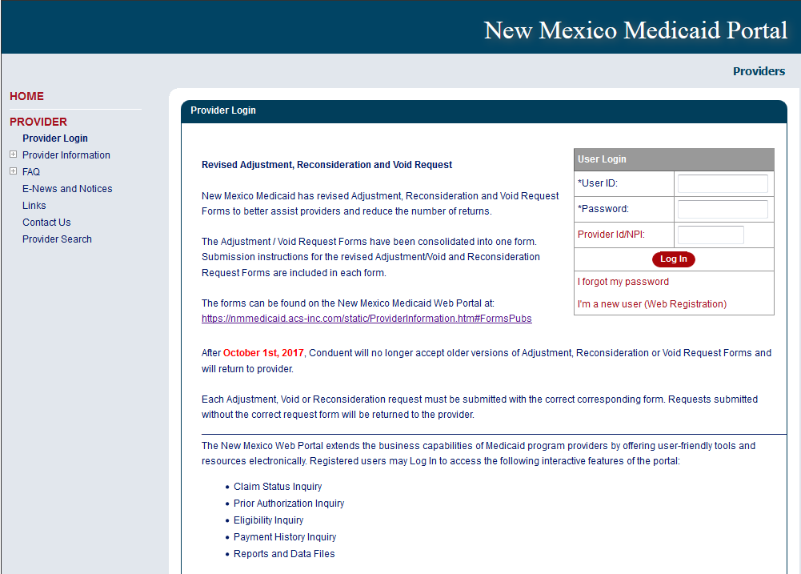
Non-secure features
Secure features requires login

Slide 6
NM Medicaid Web Portal Registration
Conduent
Government Healthcare Solutions

Slide 7
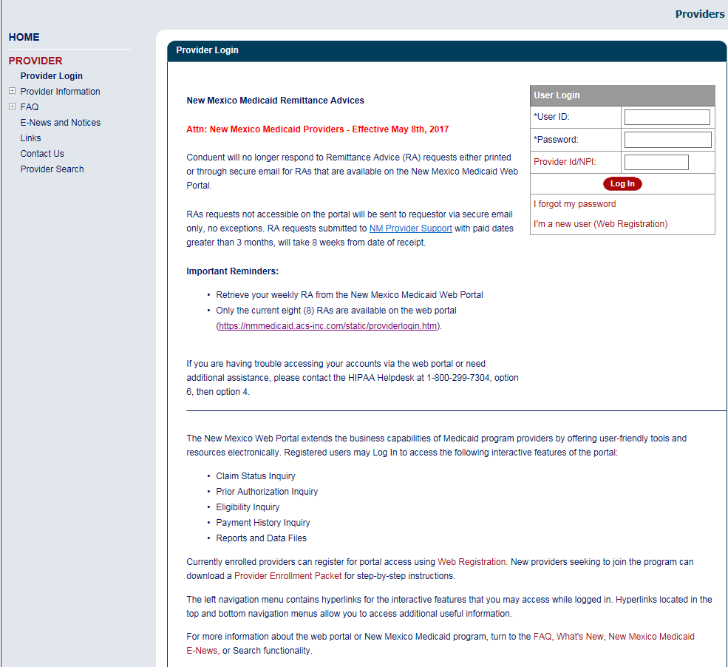
Conduent’s NM Medicaid Web Portal Login Page

Slide 8
Web Portal Registration
Large Organizations with Multiple Billing Provider Numbers
Organizations with multiple billing provider numbers have to register each billing provider number in the web portal in order to inquire on claims, Prior Authorizations (PA) and payment history, as well as to access Remittance Advices (RA) and PAs used unit reports for each of their billing provider numbers.

Slide 9
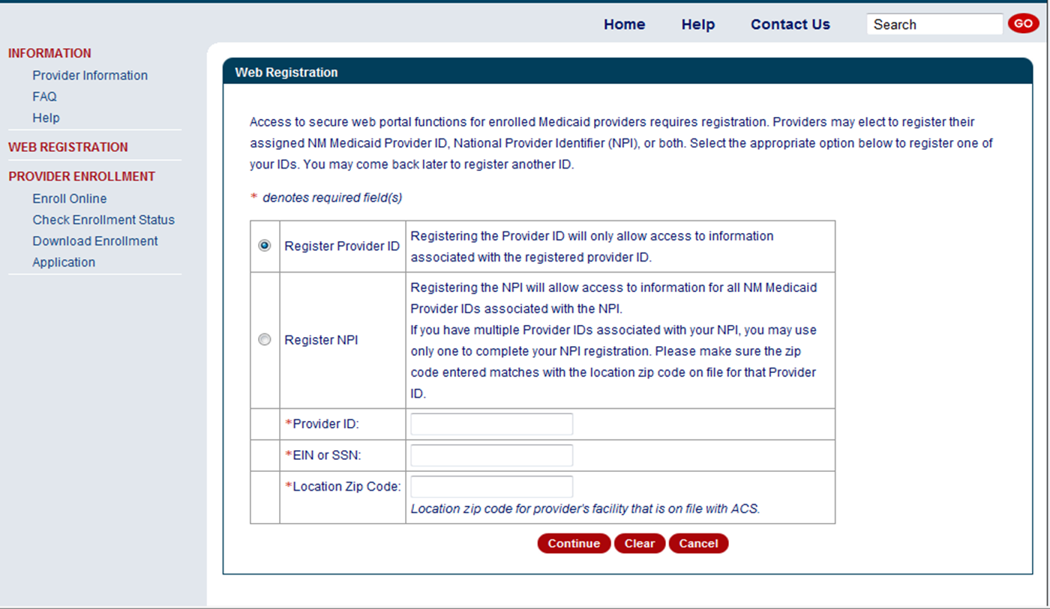
Web Portal Registration – “How To”

Slide 10
NM Medicaid Web Portal Master Administrator
Conduent
Government Healthcare Solutions

Slide 11
Master Administrator Registration

Slide 12
Master Administrator
Who has the responsibility of adding/maintaining and/or deleting users?
Master Administrator
User Administrator
The Master Administrator and those with User Administration privileges can also:
Edit user information
Remove users

Slide 13
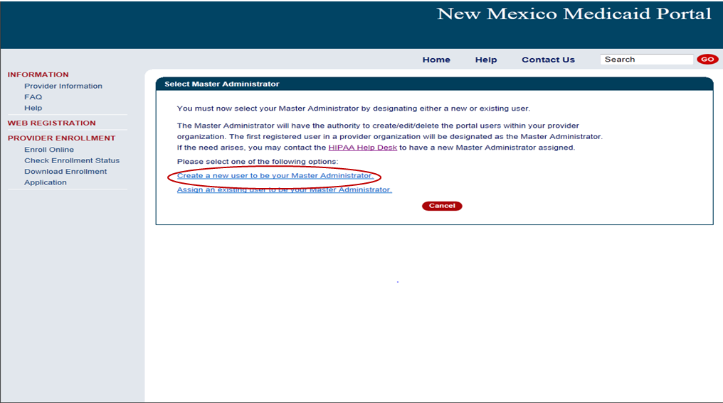
Create or Assign a Master Administrator

Slide 14
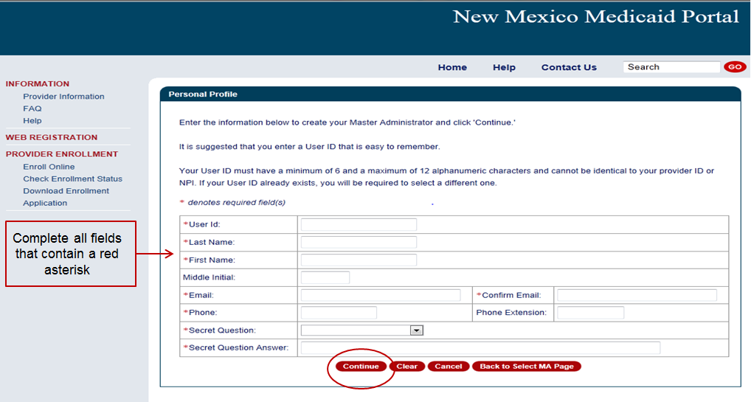
Create a Master Administrator

Slide 15
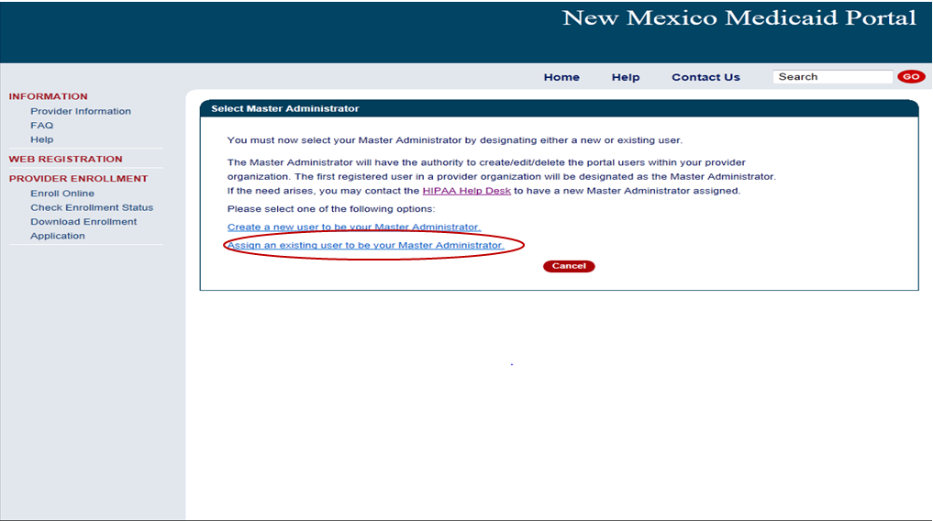
Create or Assign a Master Administrator

Slide 16
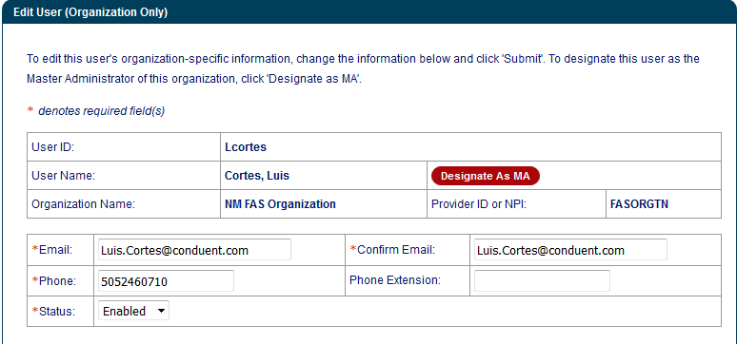
Assign Existing User to be Master Administrator

Slide 17
NM Medicaid Web Portal Users Registration & Administration
Conduent
Government Healthcare Solutions

Slide 18
User Administrator
The Master Administrator and anyone with the User Administration privileges can enroll users for the organization.
The users are assigned “privileges” and may have all or only some privileges.

Slide 19
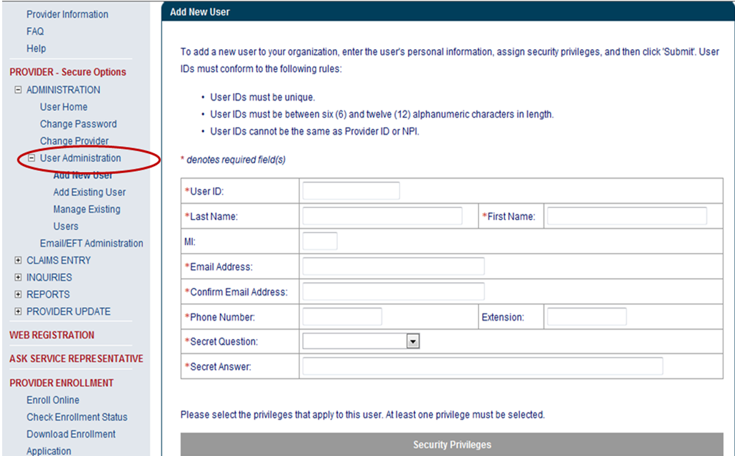
User Administration

Slide 20
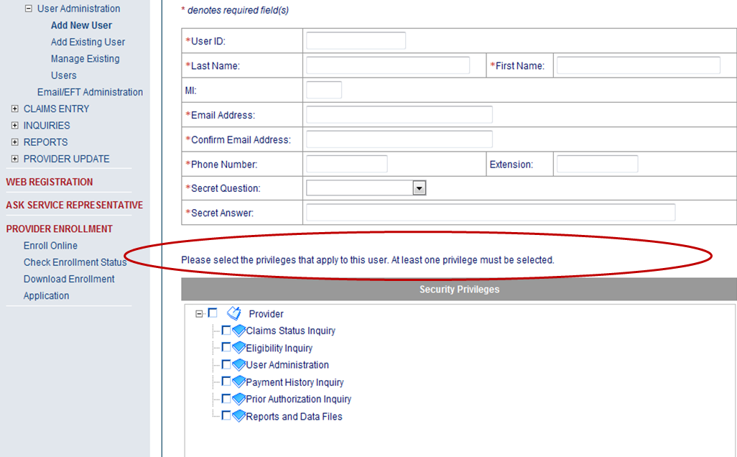
User Registration – Personal Profile

Slide 21
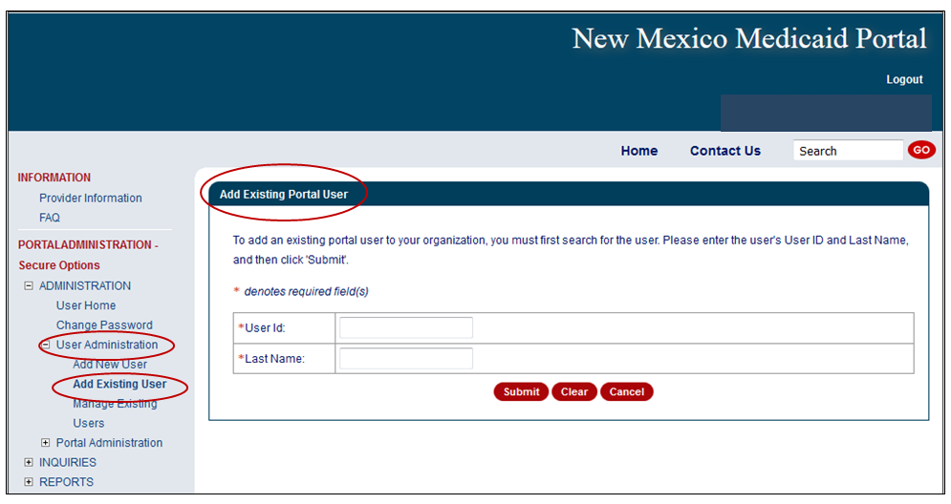
User Administration
Note: Users that are already registered in other organizations can be added to your organization.
To add an existing user, you must know the person’s user ID and last name (as it is registered in the portal).

Slide 22
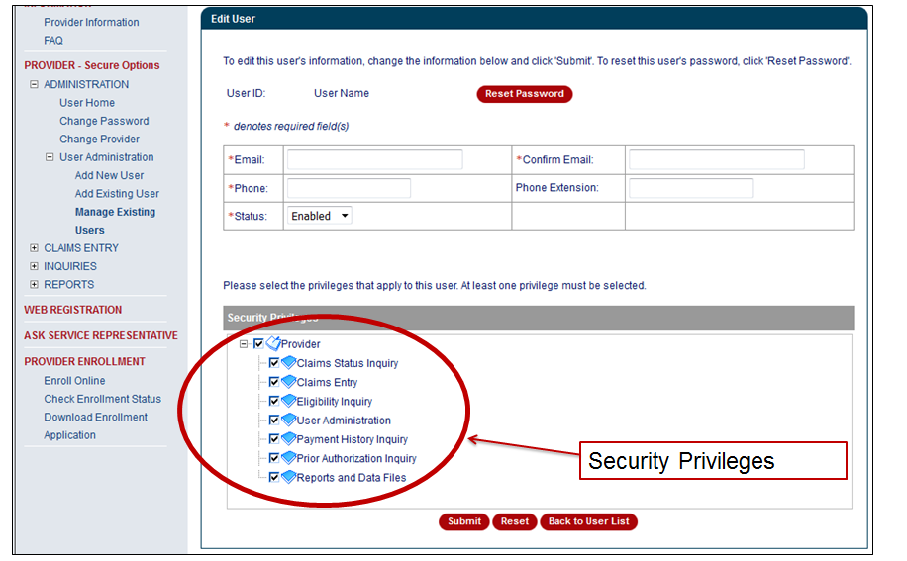
User Administration

Slide 23
User Administrator – Existing Users
Users will not need a unique user ID and password for each and every provider number they are registered within the same organization.
Registered users added to your organization will receive an “invitation” to be in your organization. The invitation is seen in the web portal when the user logs in the next time. The invitation is not emailed in this situation.

Slide 24
NM Medicaid Web Portal Users Maintenance, Login, & Forgotten Password
Conduent
Government Healthcare Solutions

Slide 25
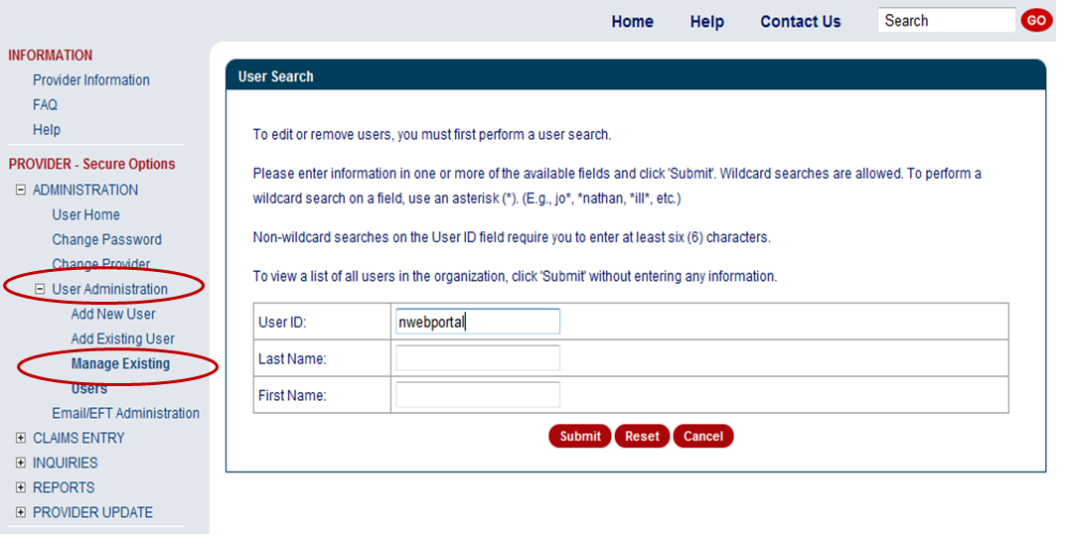
User Maintenance

Slide 26
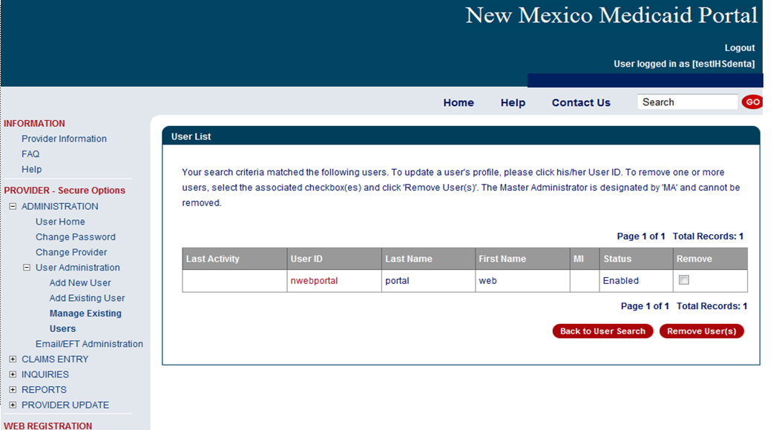
User Maintenance

Slide 27
Re-Assigned Master Administrator
Should the Master Administrator for your organization leave, a new Master Administrator must be re-assigned .
The Master Administrator can ONLY be changed by the HIPAA Help Desk via email or phone call.
HIPAA.Desk.NM@Conduent.com
800-299-7304 or 505-246-0710

Slide 28
User Login
Once you have registered, an initial password will be emailed to you.
To log in for the first time, you must enter the following:
Your User Id (assigned by the Master Administrator or the User Administrator)
The initial password sent to you via email
Your provider number
Upon the initial log in, you will be required to change your password.
The password must meet certain criteria that will be described to you on the web page.

Slide 29
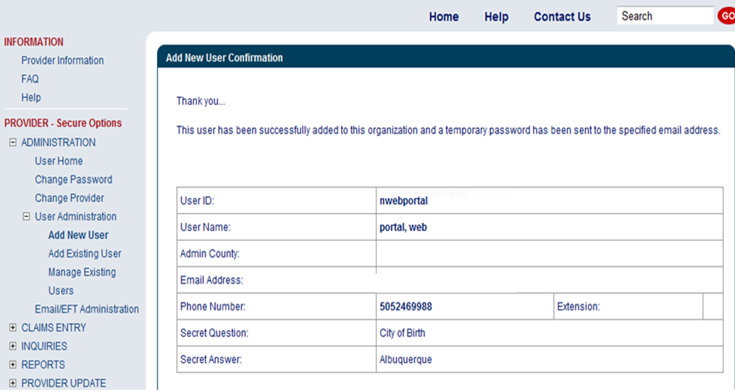
User Confirmation

Slide 30
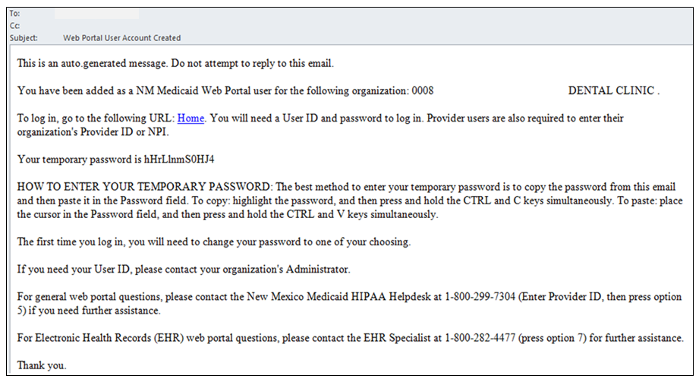
User Confirmation E-Mail

Slide 31
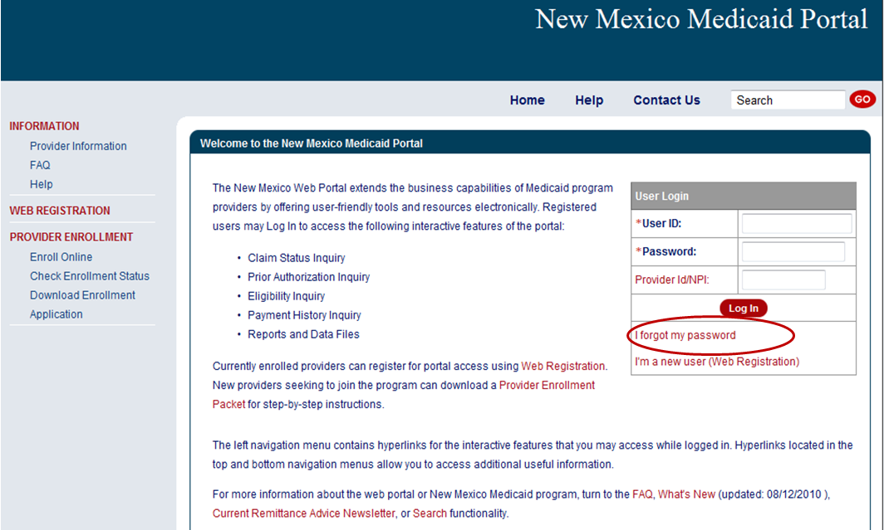
User Login – Forgot Password

Slide 32
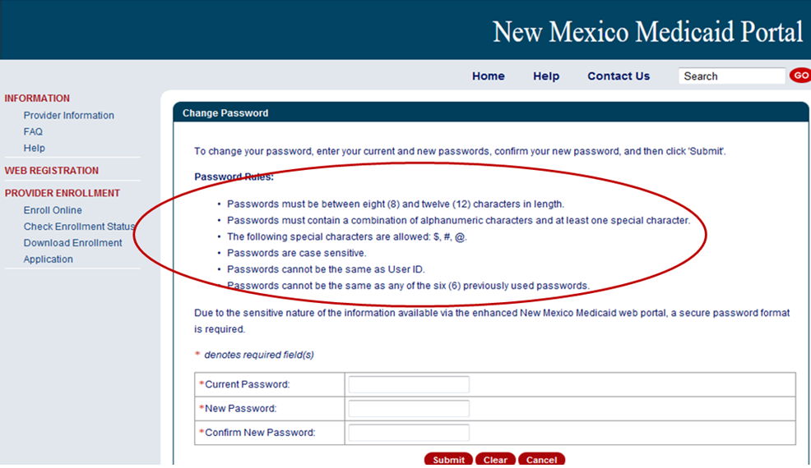
User Login – Forgot Password

Slide 33
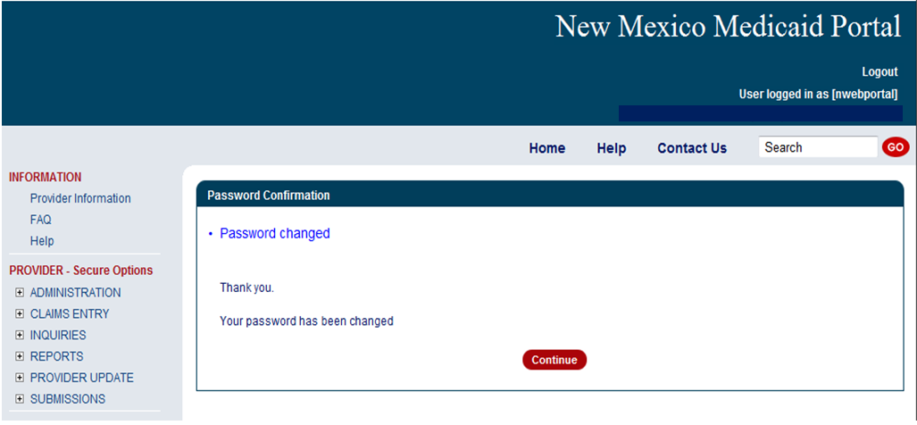
Password Confirmation

Slide 34
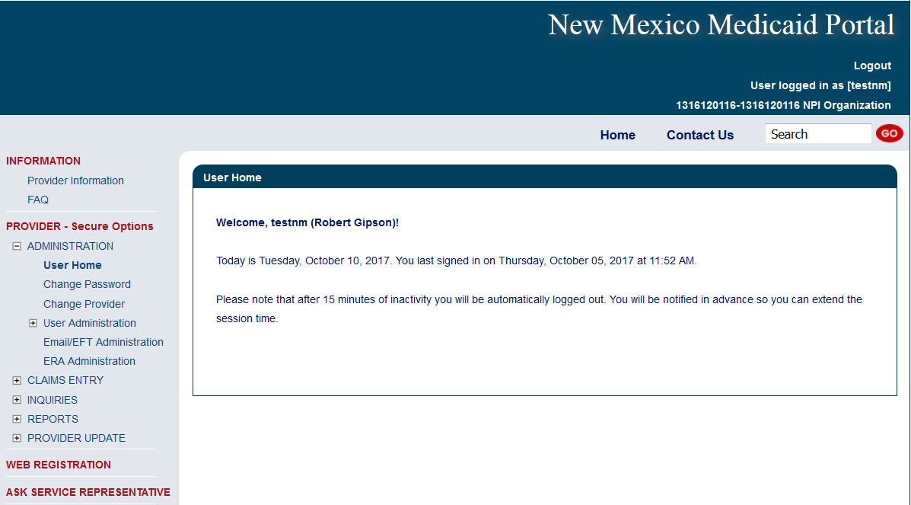
User Privileges

Slide 35
User Login
You will be asked to change your password every 60 days.
You will be notified via e-mail four (4) days before the password expires and given an opportunity to change it every time you log in during those 4 days until you are finally required to change it.
After 15 minutes of inactivity, the site will automatically log you out. If pop-ups are allowed, it will warn you that you will be logged out soon and give you the opportunity to click so that your session is extended and will not time out.
If you miss the warning, you will be logged out.

Slide 36
NM Medicaid Web Portal Technical Support
Conduent
Government Healthcare Solutions

Slide 37
New Mexico Medicaid Resources
New Mexico Medicaid Online
Provider Information
Provider Login Screen Notices
Provider E-News Newsletters
Medicaid Provider Relations Call Center
Provider Communication Updates
Provider Field Representative
Provider Webinars
Open Forums and Live Training Sessions

Slide 38
New Mexico Medicaid Resources Continued
New Mexico Medicaid Portal – https://nmmedicaid.portal.conduent.com/static/index.htm
Claim Inquiries, Eligibility Verification, Electronic Claim Submission, Provider Manuals, E-News
NM Health Care Authority – http://www.hca.nm.gov
Supplements, Memos, Provider Billing Packets and Policy
Medical Assistance Division – PE Program Staff – HSD.PEDeterminers@state.nm.us
Assistance with PE Applications, PE Determinations, MAD 070, PE Training, PE Certification
Consolidated Customer Service Call Center – (800) 299 - 7304
Claim Status, Eligibility, Prior Authorization, Medicaid Updates
Conduent Provider Relations Helpdesk – NMProviderSUPPORT@conduent.com
Claim research assistance and general Medicaid inquiries
Conduent HIPAA Helpdesk – HIPAA.DeskNM@hsd.nm.gov Assistance on NM Web Portal, EDI inquiries, and Online Claim Submission with DDE (Direct Data Entry)
Conduent Provider Enrollment Helpdesk - NMProviderSUPPORT@conduent.com
Provider Enrollment Applications, Forms & Instructions
Medical Assistance Division, Program Rules – http://www.hca.nm.gov/providers/rules-nm-administrative-code/
NMAC for Programs administered by the Medical Assistance Division Yes New Mexico - https://www.yes.state.nm.us/yesnm/home/index Apply, check, update, or renew Medical Assistance (Medicaid) benefits

